Slide 1
Object Oriented Method && C++ Program Design
Programming
Principles and Practice Using C++
Lecture 1 – Introduction
Shengfa Wang
sfwang@dlut.edu.cn

Slide 2
Lecture 1 – Introduction
1.1 About C and C++
1.2 About OOP

Slide 3
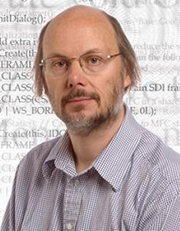

General Ideas about C++
Developed by Bjarne Stroustrup starting in 1979, it adds object oriented features, such as classes, and other enhancements to the C programming language. Originally named C with classes.
C++: more abstract, easier:
  Conciseness: 1 = many
  Maintainability: easier to modify
  Portability: suitable for different types of processors
C++ Rulez!
http://www.stroustrup.com/
Notes:
C++语言的创始人Bjarne Stroustrup 出身丹麦，在c语言的基础上引入并扩充了面向对象的概念，发明了—种新的程序语言。
此后C++语言历经了不断地完善，例如1990年c++语言引入模板和异常处理的概念，1993年引入运行时类型识别(RTTI)和名字空间(Name Space)的概念。1997年，c++语言成为美国国家标准(ANSI)。1998年，c++语言又成为了国际标准(ISO)。目前，c++语言已成为使用最广泛的面向对象程序设计语言之一。
Conciseness一行C++，往往对应若干行汇编指令

Slide 4
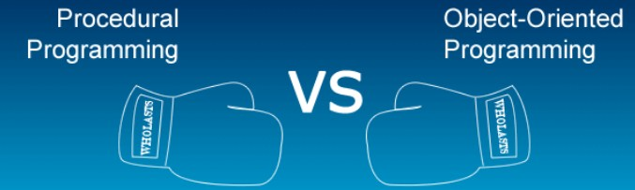
Object Oriented Programming (OOP)
linear programming
code is executed from the top of the file to the bottom;
low reusability;
stress more on algorithm rather than data
hard to understand the objective ;
use shared and global data
change a shared variable , need to find and change each place where the variable is referenced;
is not linear
code is often broken up and distributed across multiple files;
high reusability;
more abstract -- class
looks for patterns and reusability; lock their data privately away in objects;
Notes:
Disadv:
1)It stresses more on algorithm rather than data.
2)It takes more time in processing.
2)The global data is available to the function so it is easily accessed by any function, which creates certain problems.
面向过程和面向对象，这是两种思想，它们都能达到用程序来完成一件事情的能力。 只不过思维方式不一样而已。
面向过程是把一件事一项工程分解成为一个个小的功能,用一个个函数来实现.
面向对象是把事情看成是一个个小的对象组成的,或者说一个个小部分组成的,这些对象之间的相互关系,构成了整个项目.
在面向对象的思想中，万物皆对象，我是，你是，他也是。
而"类"，就是对象的抽象或者说是概括。比如，我你他都可以概括为人类。
总的来说，类是抽象的虚的，而对象是一个个活生生的具体的事物。
人是一个类，我你他就是对象。
优点是：可以重用，不必每一次用到时都重写。

Slide 5
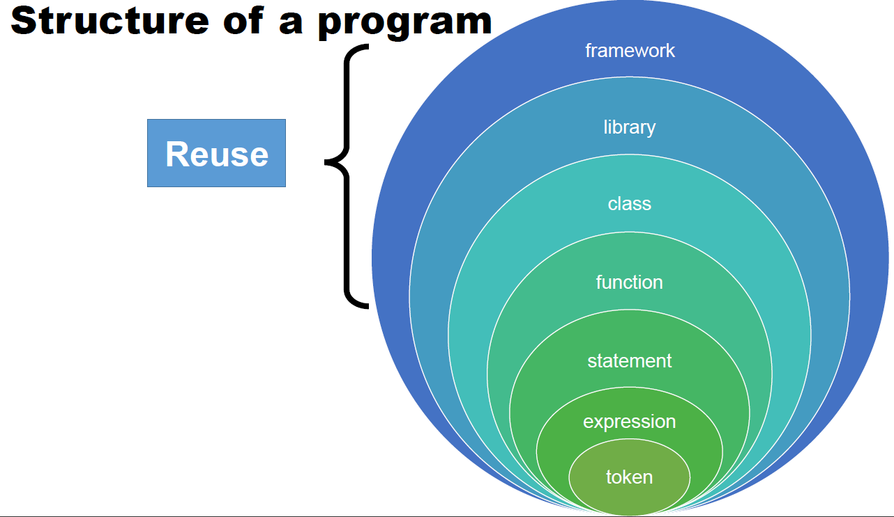
Structure of A Program

Slide 6
Difference between C and C++
S.No. | C | C++
1 | C is a structural or procedural programming language. | C++ is an object oriented programming language.
2 | Emphasis is on procedure or steps to solve any problem. | Emphasis is on objects rather than procedure.
3 | Functions are the fundamental building blocks. | Objects are the fundamental building blocks.
4 | In C, the data is not secured. | Data is hidden and can’t be accessed by external functions.
5 | C follows top down approach. | C++ follows bottom up approach
6 | C uses scanf() and printf() function for standard input and output. | C++ uses cin>> and cout<< for standard input and output.
7 | Variables must be defined at the beginning in the function. | Variables can be defined anywhere in the function.
8 | In C, namespace feature is absent. | In C++, namespace feature is present.
9 | C is a middle level language. | C++ is a high level language.
10 | Programs are divided into modules and functions. | Programs are divided into classes and functions.
11 | C doesn’t support exception handling directly. Can be done by using some other functions. | C++ supports exception handling. Done by using try and catch block.
12 | Features like function overloading and operator overloading is not present. | C++ supports function overloading and operator overloading.
13 | C program file is saved with .C extension. | C++ program file is saved with .CPP extension.
Notes:
A low-level language is a programming language that provides little or no abstraction of programming concepts, and is very close to writing actual machineinstructions. Two good examples of low-level languages are assembly and machine code.
a high-level language is a computer programming language that isn't limited by the computer, designed for a specific job, and is easier to understand. It is more like human language and less like machine language.面向对象编程就不说他的概念，如果你想建立一个电脑教室，首先要有一个房间， 房间里面要有N 台电脑，有N 张桌子， N 把椅子， 白板， 投影机等等，这些是什么，刚才咱们说了，这就是对象，能看到的一个个的实体，可以说这个电脑教室的单位就是这一个个的实体对象， 它们共同组成了这个电脑教室，那么我们是做程序，这和面向对象有什么关系呢？开发一个系统程序和建一个电脑教室类似，你把每个独立的功能模块抽象成类，形成对象，由多个对象组成这个系统，这些对象之间都能够接收信息、处理数据和向其它对象发送信息等等相互作用。就构成了面向对象的程序。

Slide 7
helloworld.cpp
// This is a comment. The compiler ignores comments.
// header information
// File iostream contains "cout" and "endl"
// Namespace std contains "cout" and "endl"
#include <iostream>
using namespace std;
int main()
{
cout << "Hello World!" << endl;
cout << "Goodbye World!" << endl;
// Exit program.
return 0;
}
Notes:
Namespace 多个张三， 在哪家的？
Explain header information #include and namespace. The header declares "what" a class (or whatever is being implemented) will do, while the cpp file defines "how" it will perform those features.
Explain main().
Explain cout() and endl.
1、"\n"是C语言风格的换行，C++具有这个是为了兼容C语言。
2、endl是标准的C++风格的换行。

Slide 8
A Simple C++ Program
<iostream>
  Must be included for any program that outputs data to the screen or inputs data from the keyboard using C++ style stream input/output.
  Replaces <stdio.h> of C

Slide 9
The main Function
int main()
{
// program statements here
return 0;
}
The main() function is where your programs will start execution, you will always need one of these.
It tells the other modules in what order to execute. In a way, it “drives” your program.

Slide 10
§18.5 Header Files
C++ Standard Library header files
  Each contains a portion of the Standard Library.
    Function prototypes for the related functions
    Definitions of various class types and functions
    Constants needed by those functions
  “Instruct” the compiler on how to interface with library and user-written components.
  Header file names ending in .h
    Are “old-style” header files
    Superseded by the C++ Standard Library header files
  Use #include directive to include class in a program.

Slide 11
include
#include <iostream> is known a preprocessor directive
It attaches the file, iostream, at the head of the program before it is compiled
“iostream” is needed to use the cout object.
Note that preprocessor directives do not end with a semicolon
Notes:
预处理指令

Slide 12
namespace
using namespace std;
tells the compiler to look in the namespace std (standard namespace) for objects (functions, classes, etc.)
cout is in the namespace std
The notation std::cout specifies a name (cout ) that belongs to the namespace std.
Namespace: a generalization of scope.
C++ allows access to multiple namespaces with the ' :: ' operator

Slide 13
namespace
Stream manipulator std::endl
  Outputs a newline.
  Flushes the output buffer

Slide 14
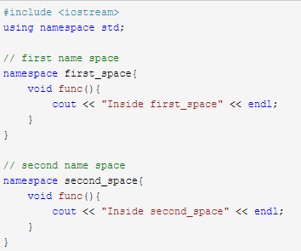
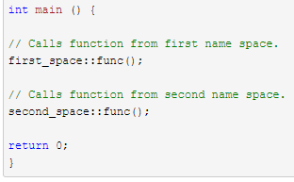
namespace

Slide 15
Outputting with cout
…
cout << "Hello World!" << endl;
cout << "Goodbye World!" << endl;
…
cout allows us to easily output data to the standard output display (your monitor). Its name comes from “Console OUTput”
In cout’s context, << is known as the insertion operator
Any literal (character string) that is to be output must be in between double quotes.
The quotes delimit the text so the computer knows it is not an instruction.

Slide 16
helloworld2.cpp
#include <iostream>
using namespace std;
int main()
{
// statements can be on multiple lines
cout << "Hello World!"
<< endl;
cout << "Goodbye World!"
<< endl; // comments can be here
return 0; // exit program
}

Slide 17
Find
bug?

Slide 18
helloworldNoInclude.cpp
// Example of compiler error.
// Forgot "#include <iostream>"
using namespace std;
int main()
{
cout << "Hello World!" << endl;
cout << "Goodbye World!" << endl;
return 0; // exit program
}

Slide 19
// Example of compiler error.
// Forgot "#include <iostream>"
using namespace std;
int main()
{
cout << "Hello World!" << endl;
cout << "Goodbye World!" << endl;
return 0; // exit program
}
> g++ helloworldNoInclude.cpp
helloworldNoInclude.cpp: In function `int main()':
helloworldNoInclude.cpp:8: `cout' undeclared (first use this function)
helloworldNoInclude.cpp:8: (Each undeclared identifier is reported only once
for each function it appears in.)
helloworldNoInclude.cpp:8: `endl' undeclared (first use this function)

Slide 20
helloworldNoNamespace.cpp
// Example of compiler error.
#include <iostream>
// Forgot "using namespace std;"
int main()
{
cout << "Hello World!" << endl;
cout << "Goodbye World!" << endl;
return 0; // exit program
}

Slide 21
// Example of compiler error.
#include <iostream>
// Forgot "using namespace std;"
int main()
{
cout << "Hello World!" << endl;
cout << "Goodbye World!" << endl;
return 0; // exit program
}
> g++ helloworldNoInclude.cpp
helloworldNoInclude.cpp: In function `int main()':
helloworldNoInclude.cpp:8: `cout' undeclared (first use this function)
helloworldNoInclude.cpp:8: (Each undeclared identifier is reported only once
for each function it appears in.)
helloworldNoInclude.cpp:8: `endl' undeclared (first use this function)

Slide 22
helloworldError1.cpp
// Example of compiler error.
#include <iostream>
using namespace std;
int main()
{
cout << Hello World! << endl;
cout << Goodbye World! << endl;
return 0; // exit program
}

Slide 23
// Example of compiler error.
#include <iostream>
using namespace std;
int main()
{
cout << Hello World! << endl;
cout << Goodbye World! << endl;
return 0; // exit program
}
> g++ helloworldError1.cpp
helloworldError1.cpp: In function `int main()':
helloworldError1.cpp:8: `Hello' undeclared (first use this function)
helloworldError1.cpp:8: (Each undeclared identifier is reported only once for
each function it appears in.)
helloworldError1.cpp:8: parse error before `!' token
helloworldError1.cpp:9: `Goodbye' undeclared (first use this function)
helloworldError1.cpp:9: parse error before `!' token

Slide 24
helloworldError2.cpp
// Example of compiler error.
#include <iostream>
using namespace std;
int main()
{
cout < "Hello World!" < endl;
cout < "Goodbye World!" < endl;
return 0; // exit program
}

Slide 25
// Example of compiler error.
#include <iostream>
using namespace std;
int main()
{
cout < "Hello World!" < endl;
cout < "Goodbye World!" < endl;
return 0; // exit program
}
> g++ helloworldError2.cpp
helloworldError2.cpp: In function `int main()':
helloworldError2.cpp:8: no match for `std::ostream& < const char[13]' operator
helloworldError2.cpp:8: candidates are: operator<(const char*, const char*) <builtin>
helloworldError2.cpp:8: operator<(void*, void*) <builtin>
helloworldError2.cpp:9: no match for `std::ostream& < const char[15]' operator
helloworldError2.cpp:9: candidates are: operator<(const char*, const char*) <builtin>
helloworldError2.cpp:9: operator<(void*, void*) <builtin>

Slide 26
helloworldError3.cpp
// Example of compiler error.
#include <iostream>
using namespace std
int main()
{
cout << "Hello World!" << endl;
cout << "Goodbye World!" << endl;
return 0; // exit program
}

Slide 27
…
#include <iostream>
using namespace std
int main()
{
cout << "Hello World!" << endl;
…
> g++ helloworldError3.cpp
helloworldError3.cpp:6: parse error before `int'
helloworldError3.cpp:9: syntax error before `<<' token
/usr/local/include/g++-v3/bits/stl_algobase.h: In function `const _Tp&
std::min(const _Tp&, const _Tp&) [with _Tp = size_t]':
/usr/local/include/g++-v3/bits/stl_algobase.h:643: instantiated from here
/usr/local/include/g++-v3/bits/stl_algobase.h:134: `__b' undeclared (first use this function)
/usr/local/include/g++-v3/bits/stl_algobase.h:134: (Each undeclared identifier
is reported only once for each function it appears in.)
/usr/local/include/g++-v3/bits/stl_algobase.h:134: `__a' undeclared (first use this function)
...

Slide 28
helloworldError4.cpp
// Example of compiler error.
#include <iostream>;
using namespace std;
int main()
{
cout << "Hello World!" << endl;
cout << "Goodbye World!" << endl;
return 0; // exit program
}

Slide 29
// Example of compiler error.
#include <iostream>;
using namespace std;
int main()
{
cout << "Hello World!" << endl;
cout << "Goodbye World!" << endl;
return 0; // exit program
}
> g++ helloworldError4.cpp
helloworldError4.cpp:3:20: warning: extra tokens at end of #include directive
> a.out
Hello World!
Goodbye World!
>

Slide 30
helloworldError5.cpp
// Example of compile error
#include <iostream>
using namespace std;
int main()
{
cout << "Hello World!" << endl
cout << "Goodbye World!" << endl
return 0; // exit program
}

Slide 31
// Example of compile error
#include <iostream>
using namespace std;
int main()
{
cout << "Hello World!" << endl
cout << "Goodbye World!" << endl
return 0; // exit program
}
> g++ helloworldError5.cpp
helloworldError5.cpp: In function `int main()':
helloworldError5.cpp:9: parse error before `<<' token
>

Slide 32
helloworldError6.cpp
// Example of compile error
#include <iostream>
using namespace std;
int main()
{
cout << 'Hello World!' << endl;
cout << 'Goodbye World!' << endl;
return 0; // exit program
}

Slide 33
// Example of compile error
#include <iostream>
using namespace std;
int main()
{
cout << 'Hello World!' << endl;
cout << 'Goodbye World!' << endl;
return 0; // exit program
}
> g++ helloworldError6.cpp
helloworldError6.cpp: In function `int main()':
helloworldError6.cpp:8: character constant too long
helloworldError6.cpp:9: character constant too long
>

Slide 34
helloworldError7.cpp
#include <iostream>
using namespace std;
int main()
{
cout << "Hello World!";
cout << "Goodbye World!";
return 0; // exit program
}

Slide 35
#include <iostream>
using namespace std;
int main()
{
cout << "Hello World!";
cout << "Goodbye World!";
return 0; // exit program
}
> g++ helloworldError7.cpp
> a.out
Hello World!Goodbye World!
>

Slide 36
helloworld3.cpp
/* This is also a comment. The compiler ignores comments. */
/* This is a multiline comment.
The compiler ignores comments.
*/
#include <iostream>
using namespace std;
int main()
{
/* These statements use '\n' for newline in place of "<< endl" */
cout << "Hello World! "\n;
cout << "Goodbye World! "\n;
return 0; /* exit program */
}

Slide 37
Comments and Programming Style
Having a good programming style is required. Indent when appropriate. You will develop a feel for this as you see more programs.
Place comments to help explain your code. Use them to describe what the program does, to put your name on the program, to describe a function, etc.
// ... is for single line comments
/* ... */ are for multi-line comments
Comments are treated as white-space, and are unseen by the compiler

Slide 38
mathExample1.cpp
// math example
#include <iostream>
#include <cmath> // File cmath contains math functions: sqrt, exp, sin, cos, ...
using namespace std; // cout, endl, sqrt, exp are in the namespace std
int main()
{
cout << "1+2+3+4+5+6 = " << 1+2+3+4+5+6 << endl;
cout << "The average of 1,2,3,4,5,6 is “ << (1.0+2.0+3.0+4.0+5.0+6.0)/6.0 << endl;
cout << "The reciprocal of 1+2+3+4+5+6 is “ << 1.0/(1.0+2.0+3.0+4.0+5.0+6.0) << endl;
cout << "The square root of 1+2+3+4+5+6 is “
<< sqrt(1.0+2.0+3.0+4.0+5.0+6.0) << endl;
cout << "e^(1+2+3+4+5+6) = " << exp(1.0+2.0+3.0+4.0+5.0+6.0) << endl;
return 0; // exit program
}
Notes:
Note #include <cmath>

Slide 39
Compiling and running mathExample1.cpp
> g++ mathExample1.cpp
> a.out
1+2+3+4+5+6 = 21
The average of 1,2,3,4,5,6 is 3.5
The reciprocal of 1+2+3+4+5+6 is 0.047619
The square root of 1+2+3+4+5+6 is 4.58258
e^(1+2+3+4+5+6) = 1.31882e+09
>

Slide 40
mathExample1.cpp (2)
…
cout << "1+2+3+4+5+6 = " << 1+2+3+4+5+6 << endl;
…
Multiple objects can be inserted into cout.
Objects that should not be taken literally should not be enclosed by double quotes. Here, we actually want to compute the expression 1+2+3+4+5+6.

Slide 41
mathError1.cpp
// math error
#include <iostream>
#include <cmath>
using namespace std;
int main()
{
// These statements are incorrect
cout << "The average of 1,2,3,4,5,6 = “ << (1+2+3+4+5+6)/6 << endl; // WRONG!
cout << "The reciprocal of 1+2+3+4+5+6 is “ << 1/(1+2+3+4+5+6) << endl; // WRONG!
return 0; // exit program
}

Slide 42
…
int main()
{
// These statements are incorrect
cout << "The average of 1,2,3,4,5,6 = “ << (1+2+3+4+5+6)/6 << endl; // WRONG!
cout << "The reciprocal of 1+2+3+4+5+6 is “ << 1/(1+2+3+4+5+6) << endl; // WRONG!
return 0; // exit program
}
> g++ mathError1.cpp
> mathError1
The average of 1,2,3,4,5,6 = 3
The reciprocal of 1+2+3+4+5+6 is 0
>

Slide 43
Syntax and Logic
Syntax is the set of rules for forming “grammatically” correct statements
This enables the compiler to translate the statements into machine language
There is a difference between syntactical correctness and logical correctness:
  If a program has syntax errors, it will not compile.
  If a program has logical errors it will compile, but will produce an incorrect result when executed.

Slide 44
A Simple Review
Simple examples in C

Slide 45
Pointer
#include <iostream>
using namespace std;
int main( )
{
int * p=0;
int x=10;
p= &x;
cout<<"x="<< x <<endl;
cout<<"&x="<< &x <<endl;
cout<<"p="<< p <<endl;
cout<<"*p="<< *p <<endl;
return 0;
}
Pointer allows us to dynamically allocate and access memory.
Memory Address | Value
002EA8F0 | 0
002EA8F1
002EA8F2
002EA8F3
002EA8F4
002EA8F5
002EA8F6
002EA8F7
002EA8F8
002EA8F9
002EA8FA
002EA8FB
//declare a pointer
// creat an integer
Memory Address | Value
002EA8F0 | 0
002EA8F1 | 10
002EA8F2
002EA8F3
002EA8F4
002EA8F5
002EA8F6
002EA8F7
002EA8F8
002EA8F9
002EA8FA
002EA8FB
// assign p to the address of x
Memory Address | Value
002EA8F0 | 002EA8F1
002EA8F1 | 10
002EA8F2
002EA8F3
002EA8F4
002EA8F5
002EA8F6
002EA8F7
002EA8F8
002EA8F9
002EA8FA
002EA8FB
Notes:
This is good to get a general understanding what pointers do and what they are, But is this useful?

Slide 46
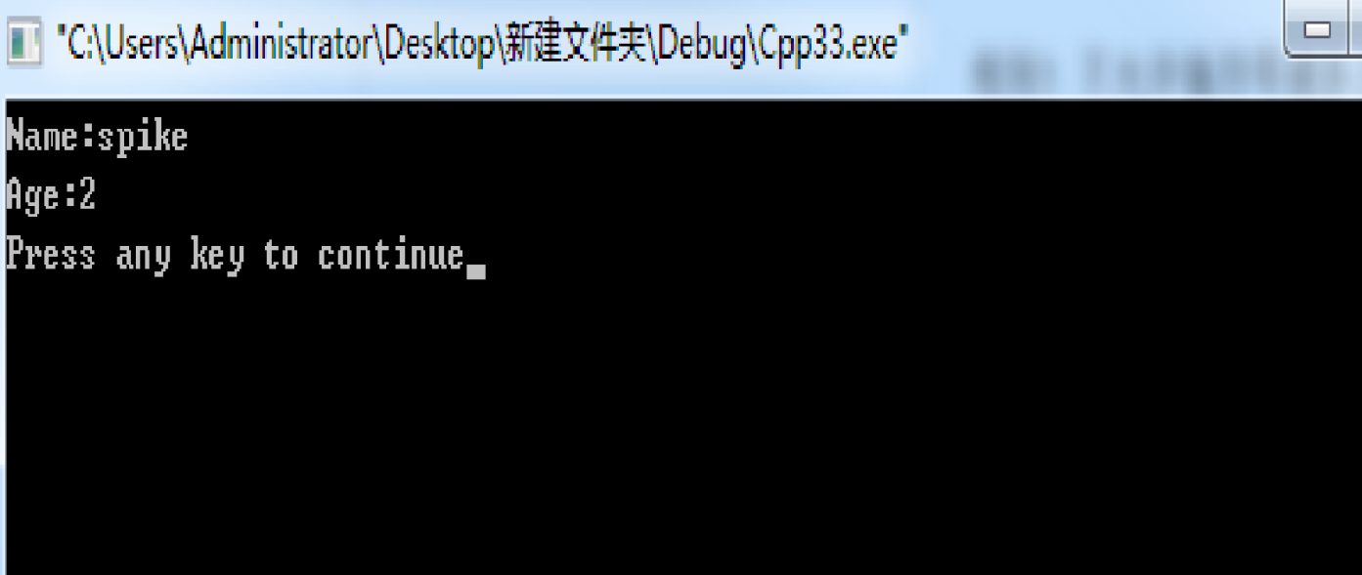
structs
#include <iostream>
#include <string>
using namespace std;
struct Dog
{
string name;
int age;
};
int main()
{
Dog d;
d.name="spike";
d.age=2;
cout << "Name:" << d.name << endl;
cout << "Age:" << d.age << endl;
return 0;
}
Notes:
Structs are very close to object oriendted .
I am assume you've already know structs, Ijust want to review them and make sure that we are on the same page before we actually go into object oriented programming .
Struct—we can give this dog a name and age
Main—we can treat this as the new type Dog now, we can name this dog like spike and age of 2
C中struct只可以放成员变量，没有访问权限限制，外部可以访问；
C++中struct用法对C中struct进行了扩展，功能与class类似，可以放成员函数，可以被继承，所有成员数据默认权限为public，struct不可以定义无参的构造函数。
C++中Class默认权限为private，可以定义无参构造函数，struct主要在这些方面与其不同。

Slide 47

Modifition
#include <iostream>
#include <string>
using namespace std;
struct Dog
{
string name;
int age;
};
int main()
{
Dog d;
d.name="spike";
d.age=2;
cout << "Name:" << d.name << endl;
cout << "Age:" << d.age << endl;
return 0;
}
void initDog(Dog d, string name, int age);
initDog(d,"damao",4);
void initDog(Dog d, string name, int age)
{
d.name=name;
d.age=age;
}
Notes:
OK, Now what we can do is to define functions and help us modify this. Above main function here we are about to make a function call.
I am going to make a function , declare that.
Now we should be able to call this function, and change our dog’s name and age, we pass in our dog d, and we give it a name, damao, and we give a new age of 4.
When we compile, the result is not the case that we want.
The reason for this is when we make a function call , our program actually a make a copy of this dog d. Any change that has made to this is local to this function.

Slide 48
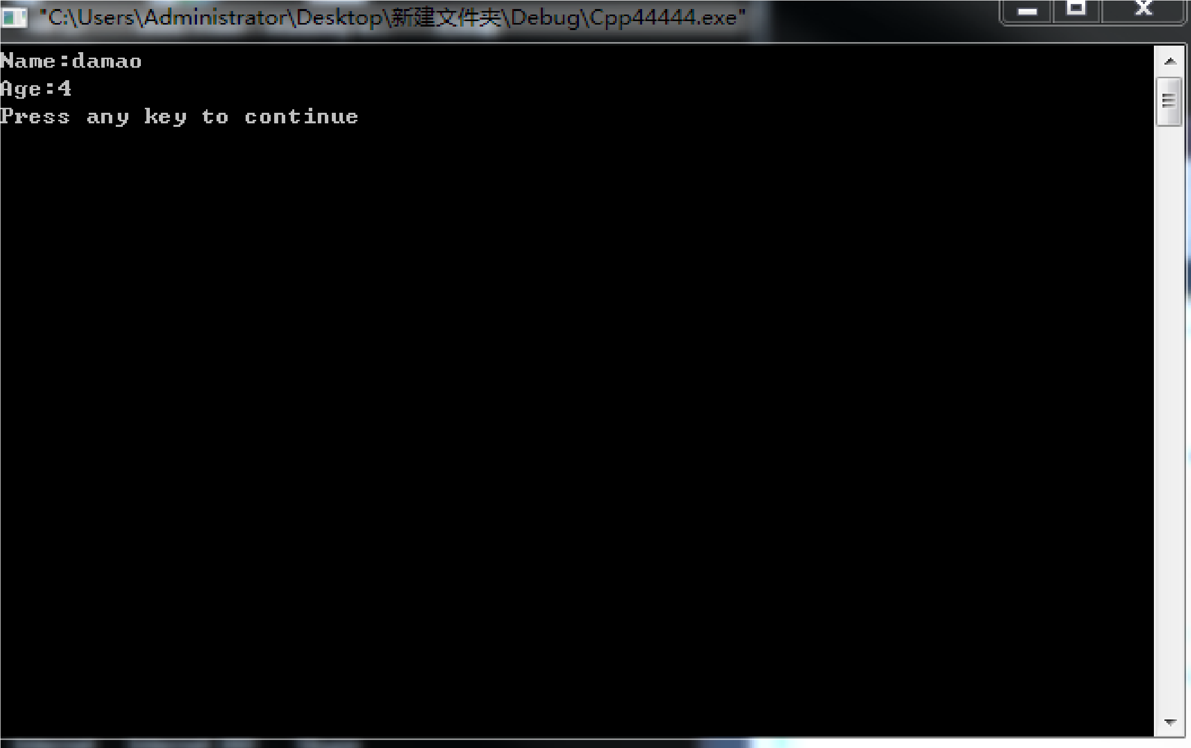
Passing by Reference
#include <iostream>
#include <string>
using namespace std;
struct Dog
{
string name;
int age;
};
void initDog(Dog d, string name, int age);
int main()
{
Dog d;
d.name="spike";
d.age=2;
initDog(d,"damao",4);
cout << "Name:" << d.name << endl;
cout << "Age:" << d.age << endl;
return 0;
}
void initDog(Dog d, string name, int age)
{
d.name=name;
d.age=age;
}
&
&
Notes:
Reference operator could fix this, which is the ampersand.
What this does actually tells the program rather than make a copy at the actual dog or modify the actual dog we pass in, so rather than passing in the whole new dog and making a copy of it, we are just taking the address of the dog and making changes to the dog we pass in. so that’s fix the problem.
In function calls, any variables you pass in, unless they are passed by reference or by pointer , any changes made to them is going to be local to that function , and it wont affect anything outside of that function.

Slide 49
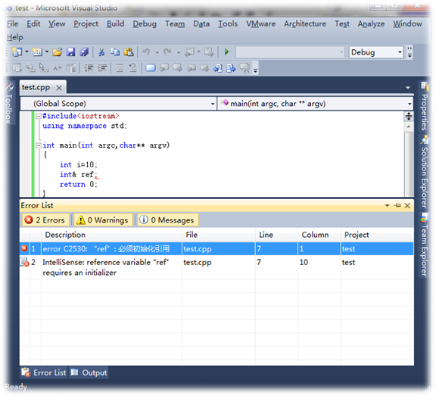
Difference between Reference and Pointer
Pointer could be null, but reference could not
Pointer should be checked null or not before used, but reference is not necessary!!

Slide 50
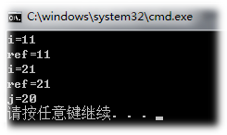
Difference between Reference and Pointer
reference could not change the object, but pointer could
#include<iostream>
using namespace std;
int main(int argc,char** argv)
{
int i=10;
int& ref=i;
ref++;
cout<<"i="<<i<<endl;
cout<<"ref="<<ref<<endl;
int j=20;
ref=j;
ref++;
cout<<"i="<<i<<endl;
cout<<"ref="<<ref<<endl;
cout<<"j="<<j<<endl;
return 0;
}
"指针指向一块内存，它的内容是所指内存的地址；而引用则是某块内存的别名，引用不改变指向。"

Slide 51
Difference between Reference and Pointer
"指针指向一块内存，它的内容是所指内存的地址；而引用则是某块内存的别名，引用不改变指向。"

Slide 52
OOP
Class and object
Class
Object
Sandy
Jack
Property (members)：
name；
gender ;
…
action (methods)：
run；
jump；
talk；
…
property：
name=Sandy;
gender =F;
…
action ：
run；
jump；
talk；
…
property：
name=Jack;
gender=M ;
…
action ：
run；
jump；
talk；
…
Notes:
如果你去中关村想买几台组装的PC 机，到了那里你第一步要干什么，是不是装机的工程师和你坐在一起，按你提供的信息和你一起完成一个装机的配置单呀，这个配置单就可以想象成是类，它就是一张纸，但是它上面记录了你要买的PC 机的信息，如果用这个配置单买10 台机器，那么这10 台机子，都是按这个配置单组成的，所以说这10 机子是一个类型的，也可以说是一类的。那么什么是对象呢，类的实例化结果就是对象,用这个配置单配置出来（实例化出来）的机子就是对象，是我们可以操作的实体，10 台机子，10 个对象。每台机子都是独立的，只能说明他们是同一类的，对其中一个机做任何动作都不会影响其它9 台机器，但是我对类修改，也就是在这个配置单上加一个或少一个配件，那么装出来的9 个机子都改变了，这是类对象的关系(类的实例化结果就是对象)。

Slide 53
Example
Example 1: Input a radius of circle, calculate the girth and area.
Data description:
double radius, girth , area;
Data processing :
input the radius r;
calculate the girth = 2*π*r ;
calculate the area= pi * r² ；
output radius, girth , area;

Slide 54
Procedural Programming
#include <iostream>
int main( )
{ double r;
std:: cout<<"input the radius";
std:: cin>>r;
std:: cout<<"the radius is: "<<r<<"\n";
std:: cout<<"the area is: "<<r*r*3.14 <<"\n";
std:: cout<<"the girth is: "<<2*r*3.14 <<"\n";
//… more circles
return 0;
}
Notes:
r replaced by 2r
r*r

Slide 55
OOP
Example 1: Input a radius of circle, calculate the girth and area.
Analysis
‘circle’ is an abstract class type
radius？
instantiation
create objective circle (object)
girth？
area？
Notes:
We could instantiate several objects of that class which is this abstract circle.
How are we going to create objects which are these circles, use radius, which is the member in class. And having the radius helps us calculate the girth and area.

Slide 56
OOP
Example 1: Input a radius of circle, calculate the girth and area.
Analysis
Circle class
data member
radius;
member function
setRadius;
getRadius;
getGirth;
getArea;
instantiation

Slide 57
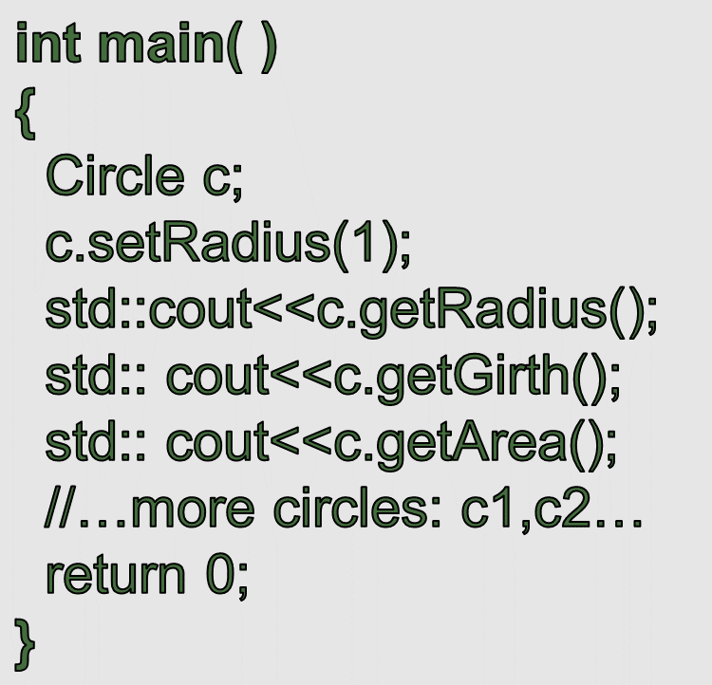
OOP
#include <iostream>
class Circle
{
double radius;
public:
void setRadius(double r)
{radius=r; }
double getRadius()
{return radius; }
double getGirth()
{return radius*2*3.14; }
double getArea()
{return 3.14*radius*radius;}
};
Notes:
by default, members of a structure are public; members of a class are private.

Slide 58
OOP
OOP Character
1
2
3
Encapsulation：
Data encapsulation is the most striking feature of a class.
Data hiding or information hiding.
Inheritance:
Subclasses can inherit instance variables and member functions of its superclasses.
Used by programmers to reduce programming time.
Polymorphism:
Some code or operations behave differently in different contexts.
Such as plus (+);
Notes:
封装：一是把对象的全部属性和行为结合在一起，形成一个不可分割的独立单位；二是尽可能隐蔽对象的内部属性和实现细节，对外形成一道屏障，与外部的联系只能通过公共接口实现。
继承：子类自动共享父类数据和方法的机制，它由类的派生体现。一个子类直接继承父类的全部描述，同时可修改和扩充，继承是对父类的重用机制。
多态性：是在继承体系结构中，同一消息为不同的对象接受时可产生完全不同的行动。利用多态性用户可发送一个通用的信息，而将所有的实现细节都留给接受消息的对象自行决定。

Slide 59
What is encapsulation
The prevention of "unauthorized access" to stuff
Encapsulation will force users to rely on the interface rather than the implementation.
The properties of the C++ keywords private and protected actually implement encapsulation.

Slide 60
Inheritance
Inheritance allows us to define a class in terms of another class, which makes it easier to create and maintain an application.
Inheritance also provides an opportunity to reuse the code functionality and fast implementation time.
The idea of inheritance implements is a relationship. For example, mammal IS-A animal, dog IS-A mammal hence dog IS-A animal as well and so on.
Notes:
When creating a class, instead of writing completely new data members and member functions, the programmer can designate that the new class should inherit the members of an existing class. This existing class is called the base class, and the new class is referred to as the derived class.

Slide 61

Polymorphism
POLY MORPHISM (TWO GREEK WORDS)
MANY FORMS
Typically, polymorphism occurs when there is a hierarchy of classes and they are related by inheritance.
C++ polymorphism means that a call to a member function will cause a different function to be executed depending on the type of object that invokes the function.
Notes:
When we say something polymorphic in programming, what we mean is that something exhibits multiple forms or multiple behaviors.
Think of this way, if you press a computer power button right now, and your computer will turn off, and if you press it again, your computer will turn back on.
Even your computer power butter does not look like it’s changed at all. It actually has different forms and behaviors.

Slide 62





OOP
OOP Character
1
2
3
Encapsulation ：
student
teacher
test paper
Inheritance :
person
student
teacher
Polymorphism :
Sandy.examination（）
Jack.examination（）
Teacher tests students

Slide 63
Homework:
Make Your First C++ Program!
//This program outputs the message “Hello, World!” to the monitor
// A Hello World program
# include <iostream>
int main() //C++ programs start by executing the function main
{
  std::cout << "Hello, world!\n"; // output “Hello, world!”
  return 0;
}

Slide 64
C++ Program
code
compile
link
run

Slide 65
Useful Links
http://www.cplusplus.com
Introduction to C++, MIT
http://ocw.mit.edu/courses/electrical-engineering-and-computer-science/6-096-introduction-to-c-january-iap-2011/
C++ course, Cambridge
http://www-h.eng.cam.ac.uk/help/tpl/languages/C++.html
The support site of this book, Stroustrup
http://www.stroustrup.com/Programming/

